Slide 1
Network Intrusion Detection with Modern Tabular ML
By Andrew Pfeiffer, Ben Kammler, and Mason Kotlarz
Notes:
All intro - then Ben take over
Hello, we are doing our presentation over performing network intrusion detection with modern tabular machine learning. My name is Ben…

Slide 2

Introduction
Why IDS matters now
What is wrong with the current state
What we built
Notes:
Ben
Modern networks see millions of connections every day, and every business is a target. A good IDS is the difference between catching an attack within minutes versus discovering a breach months later, after the damage is already done.
One problem with many production IDS today is that they're signature-based. They check incoming traffic against a database of known attack patterns. The issue is that signatures are reactive — you only get one after an attack has been seen, analyzed, and added to the database. By that time, attackers have already moved on. Even small variants of known attacks can slip past entirely.
What we built is a machine learning model — XGBoost specifically — trained on 2.5 million network flows from the CIC-IDS-2017 dataset. Instead of memorizing attack signatures, this model learns the underlying patterns of malicious behavior. We then built our own attack lab to validate that the model could detect attacks on traffic it had never seen before.
Image: https://media.licdn.com/dms/image/v2/C5612AQEZGS4juHU6_g/article-cover_image-shrink_600_2000/article-cover_image-shrink_600_2000/0/1520138609984?e=2147483647&v=beta&t=4YFE0H9Bs98--GC4xjI2WLxT9gKIY1bx3IKikEonbsM

Slide 3
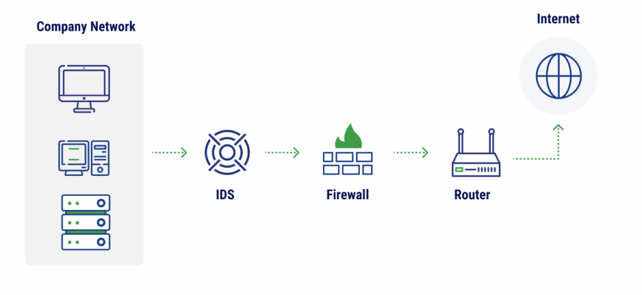



IDS Fundamentals
Signature-based vs anomaly-based detection
ML-based anomaly detection is a popular option
Notes:
Ben
There are two main approaches to intrusion detection. The first is signature-based, which works by pattern matching against a known database. It's similar to traditional antivirus — if a file's hash matches known malware, you block it. This approach is fast and accurate for known threats, but it's essentially useless against anything new.
The second approach is anomaly-based, which builds a model of what "normal" traffic looks like and flags deviations from that baseline. This can actually catch new attacks, but it has its own downsides as it produces a lot of false positives if the baseline isn't right, and "normal" can change over time.
Machine learning-based anomaly detection has been gaining traction recently for a few reasons. ML can learn complex patterns across many features simultaneously — patterns that a human couldn't easily write rules for. It can also generalize from training examples to new variants. Companies like Cisco with SnortML, CrowdStrike with their Falcon agent, and Palo Alto Networks all use ML in their IDS and EDR products today.
Our project falls into the anomaly-based ML category. The goal isn't to replace signature-based systems, but to complement them and catch what they miss.

Slide 4
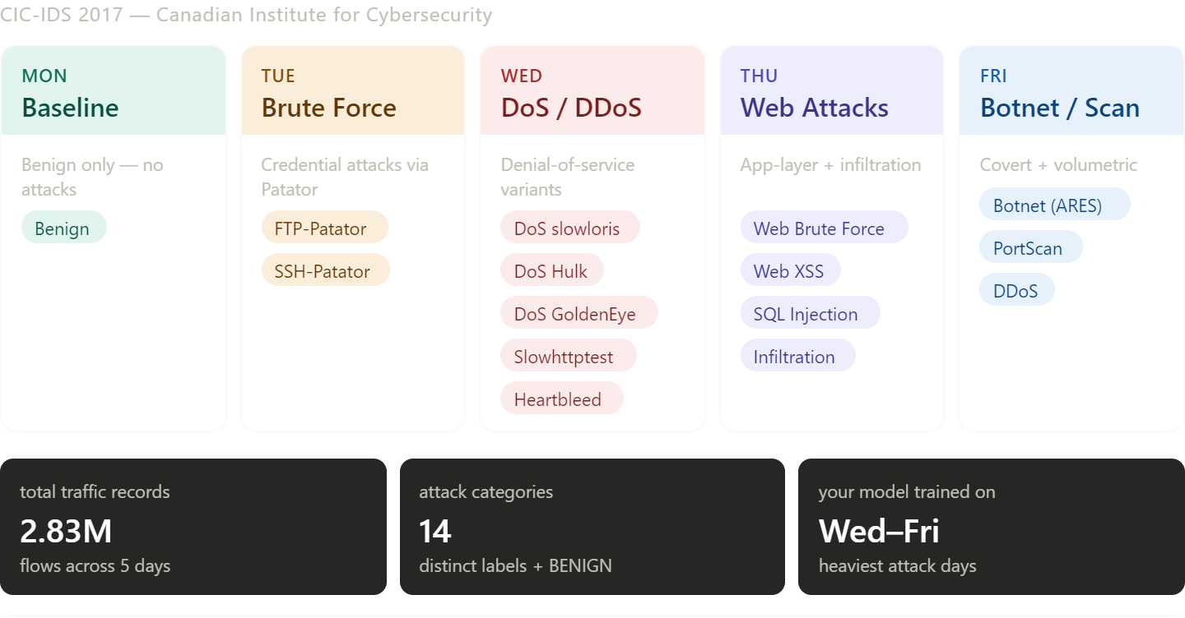
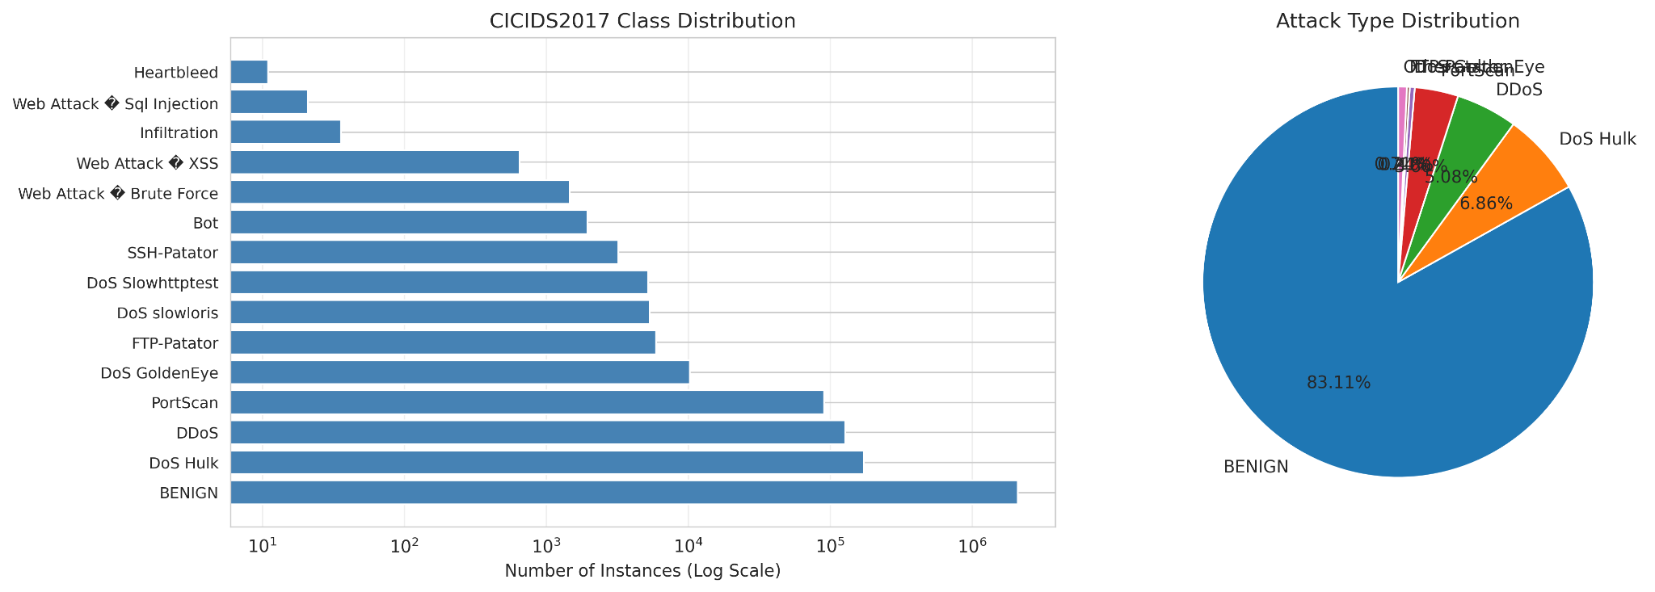
CIC-IDS-2017 Dataset
Notes:
Ben
CIC-IDS-2017 was one of the standard public benchmarks for IDS research, generated by the Canadian Institute for Cybersecurity. It originally has about 2.8 million flows, but after we removed duplicates and bad rows we ended up with around 2.5 million.
Each flow has 80 features, including things like flow duration, packet count, mean inter-arrival time, total bytes, and TCP flag distributions. These features are computed by a tool called CICFlowMeter from raw network captures.
We use flow-based features instead of raw packets for a few reasons. First, scale because a flow summary is only hundreds of bytes, while the underlying packets could be megabytes, which is critical for real-time inference. Second is generalization because patterns of how traffic flows tend to be more robust to small variations than raw packet contents. And third, flow features are encryption-resilient. Since we're not inspecting payloads, they still work on encrypted traffic.
The dataset has 15 attack categories, including DDoS, multiple DoS variants, port scans, brute force, web attacks, botnets, and infiltration — plus a benign class.
As you can see, there's a massive class imbalance in the dataset. 83% of all flows are benign. Some attack classes have over 100,000 examples, DoS Hulk for instance, while others have fewer than 20, like Heartbleed and SQL Injection. This imbalance was a challenge we had to overcome, and we'll talk more about how we handled that later.

Slide 5
Project Goals
Implement the ML mode from the paper (Baseline)
Create a virtual network scenario to generate attack data flows
Test & Evaluate the ML model on virtual network data
Implement the model in the virtual environment for real-time detection
Notes:
Andrew

Slide 6
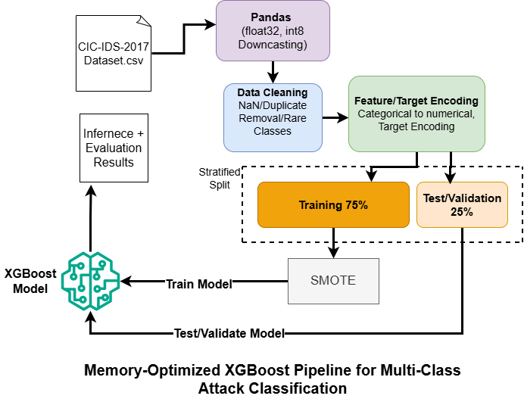
Data Preparation Pipeline (Baseline Model)
Notes:
Andrew
Memory optimization for Colab: Free Colab gives you ~13GB RAM. The full dataset in default float64 didn't fit. We downcast float64 → float32 and int64 to the smallest fitting integer type. Cut memory roughly in half. Mention how that let us train on the full 2.5M records instead of a 10% sample like our initial run was forced to do.
Cleaning:
Stripped whitespace from column names (the raw CSV had inconsistent spacing)
Replaced infinity values with NaN — they came from features like "bytes per second" on flows that lasted 0 seconds (division by zero)
Dropped about 308,000 duplicate rows so the model learns patterns instead of memorizing specific flows
Removed 8 zero-variance features that had identical values everywhere (no information content)
Final: 2,520,792 records × 70 features × 15 classes
Class imbalance problem: This is the lead-in to the next slide. "But after all that cleaning, we still had a fundamental problem with the data: massive class imbalance." 83% benign, with attack classes ranging from hundreds of thousands of samples down to single digits. Standard ML training would just learn 'predict benign' and get 83% accuracy — useless for a security tool.

Slide 7
Hybrid Balancing Approach
SMOTE for mid-range minority classes (50+ samples)
Inverse-frequency class weighting for extreme minorities (< 50 samples)
Why hybrid?
75/25 train-test split
Notes:
Andrew
The core dilemma: Two main approaches to imbalance — oversample the minorities (SMOTE) or weight them more heavily during training (class weighting). Each has tradeoffs.
SMOTE for mid-range classes: SMOTE = Synthetic Minority Over-sampling Technique. It generates new synthetic samples by interpolating between existing minority-class examples. Works great when you have at least ~50 real samples to interpolate from — gives the model more examples to learn the pattern.
Inverse-frequency weighting for extremes: For classes with under 50 samples (Heartbleed had 11, SQL Injection had ~20), SMOTE breaks down — interpolating from 11 points produces unrealistic synthetic data. Instead, we kept the original samples and told the model "misclassifying these is much more costly." The smaller the class, the bigger the penalty.
Why hybrid: Pure SMOTE damages tiny classes. Pure weighting doesn't help mid-range classes enough. The hybrid uses each technique where it works best. We also dropped Heartbleed entirely — too few samples even for weighting to help.
75/25 train-test split: Tested both 80/20 and 75/25. Performance was nearly identical, so we picked 75/25 because it matches the methodology in Engelen et al. 2021's CIC-IDS-2017 analysis paper, and gives a larger test set (~630k samples) for evaluating rare classes.

Slide 8
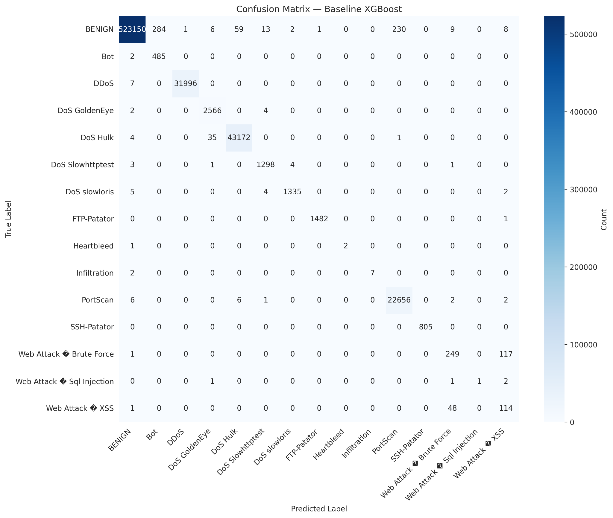
Baseline Model Performance
Trained on 70+ features
99.86% accuracy on CIC-IDS-2017 test set
0.8692 macro F1
High accuracy was a red flag
Notes:
Andrew
Model compared to be about equal with the results the researchers initially got
99.86% accuracy, 0.8692 macro F1: Accuracy looks amazing because of the class imbalance — even a "predict benign always" baseline would get 83%. The macro F1 score is more honest because it weights all classes equally regardless of size.
Strengths (point to confusion matrix):
DDoS: 31,996 correct, only 7 missed (recall >99.9%)
DoS Hulk: 43,172 correct, 40 missed
PortScan: 22,656 correct, 17 missed
These are high-volume attacks with very distinctive signatures — the model nails them.
Smaller-but-distinctive classes also work well: SSH-Patator 805/805, FTP-Patator 1482/1483.
Weaknesses:
Web Attack subtypes confused with each other: XSS frequently misclassified as Web Attack Brute Force, and vice versa. Both are HTTP-layer attacks with similar request patterns — even a human looking at flow features alone would struggle to tell them apart. XSS precision is only 46%.
Tiny classes are unreliable: Heartbleed (2 test samples), Infiltration (7), SQL Injection (4 total, only 1 correct). With this few examples, a single misclassification swings the metric heavily. Not really a model problem — it's a data problem.
Some benign-as-attack false positives: 230 benign flows misclassified as PortScan, 284 as Bot. Out of 523,000 benign flows that's a ~0.1% false positive rate, but worth noting for production deployment.

Slide 9
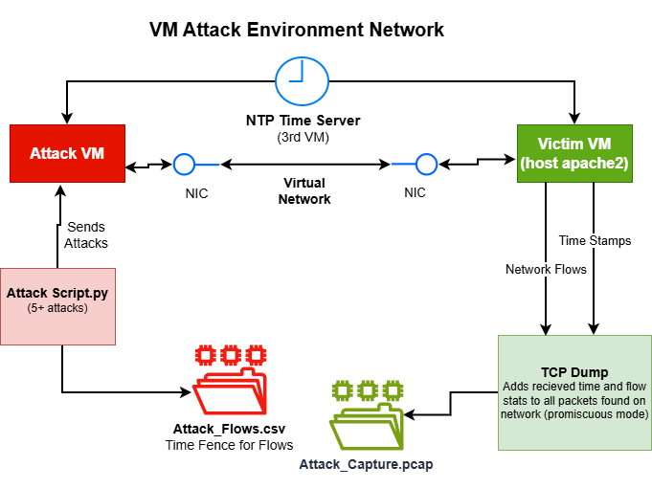
Testing / Demo
Proxmox
NTP time synchronization
Attack script
Port scan - nmap
DDoS SYN flood
DDoS TCMP
DDoS UDP
DoS Hulk
Notes:
Mason
VM diagram (when added): Walk the audience left-to-right through the topology. Attacker, victim, time server. Show network flows with arrows.
Attacks we'll demo — give a one-liner for each:
Port scan (nmap): Reconnaissance attack. Scans every port on the victim looking for open services. Generates many short flows on different destination ports, all from one source — that's the signature.
DDoS SYN flood: TCP SYN flood with hping3 at 1000 packets per second. Half-opens connections without completing them, exhausting the victim's connection table. High-volume signature.
DDoS ICMP flood: Ping flood. Same volume signature but ICMP protocol — tests whether the model handles non-TCP DDoS.
DDoS UDP flood: UDP packets to closed ports. Victim responds with ICMP "port unreachable" for each — that's the bidirectional traffic pattern.
DoS Hulk: Application-layer DoS. 50 concurrent threads making real HTTP requests with randomized URLs to defeat caching. Different signature from network-layer floods because every request is a complete TCP+HTTP transaction.
Botnet beacon: Simulated command-and-control heartbeat. Single TCP connection every few seconds with a small payload. Low-volume, periodic, long-duration — the hardest signature to detect because there's no volume to alert on.
What success looks like: Each pcap gets converted to flows, labeled by our ground truth fence, and fed into the model. We compare the model's prediction against the true label. Per-attack accuracy is what we'll report.

Slide 10
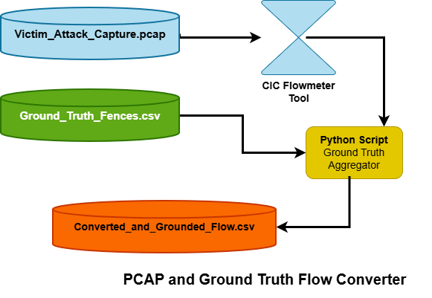
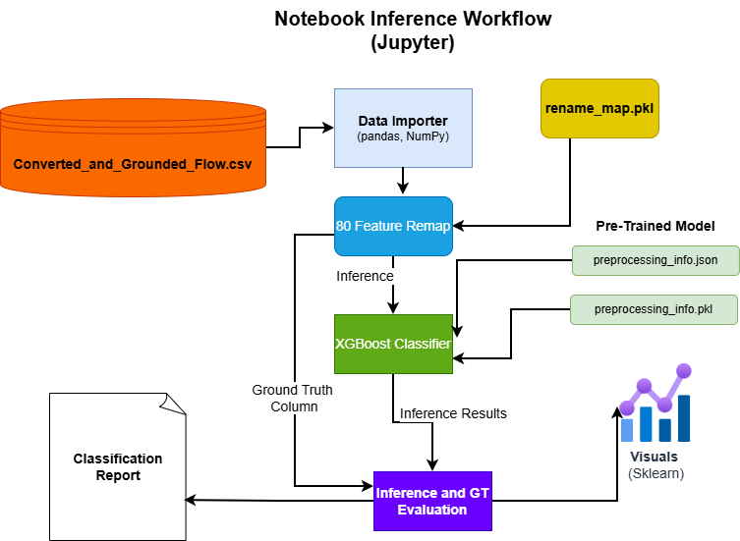
Extracting VM data
Notes:
Mason

Slide 11
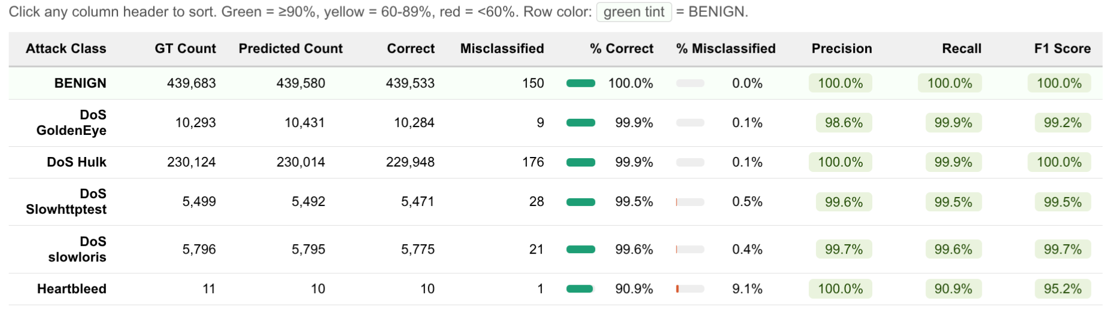
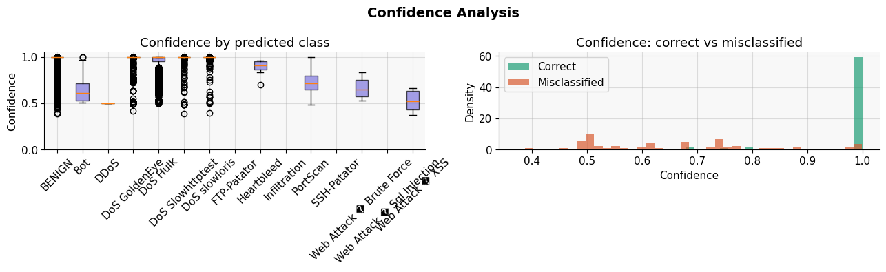
Baseline Issues
Notes:
Mason
Overfit no good
Near-perfect scores on held-out test data did not transfer to real traffic
Model failed to correctly classify attacks generated by our own attack scripts
Root cause: time-based and flow-timing features are dataset-specific and not reproducible in live environments

Slide 12
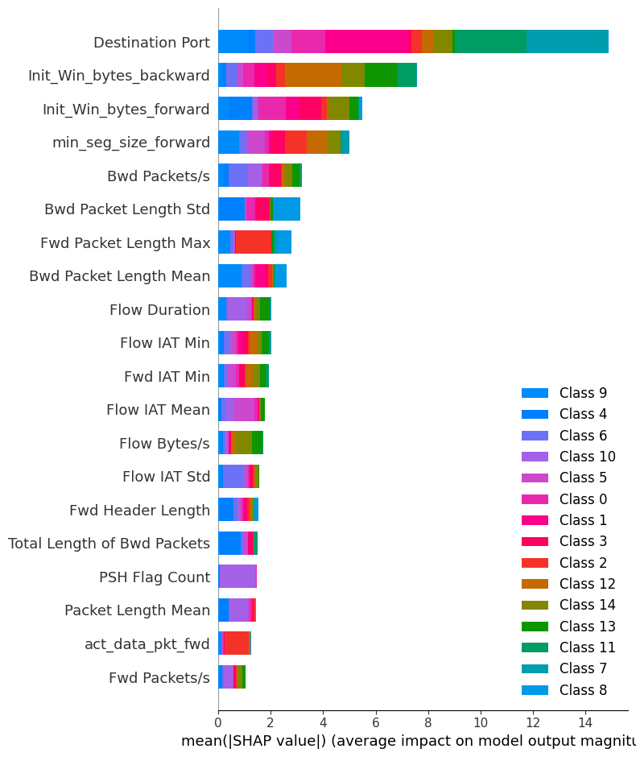
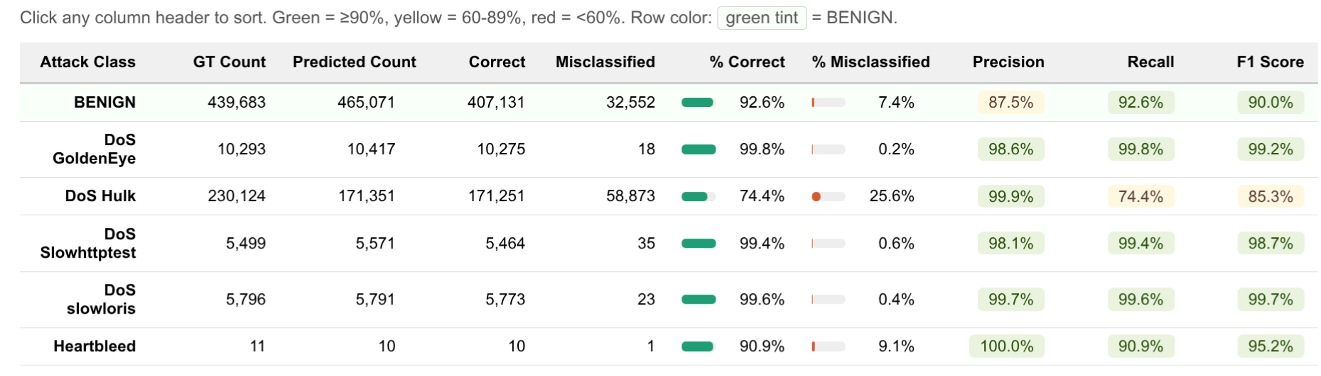
Retrained Model
70+ → 43 Features
Key retained features: Destination Port, Init_Win_bytes_forward/backward, min_seg_size_forward
Complete failure on VM data
CIC Inference results
Notes:
Mason
Got the SHAPley values after retraining and evaluating again. Saw fewer overfitted categories across the board. Saw great results with HEARTBLEED detection but poor performance on our other atta
Further reduced to 15 features based on SHAP importance — focused on packet length stats and TCP flag counts
Final feature set: Fwd/Bwd Packet Length stats, Total Fwd/Bwd Packets, PSH/ACK/SYN/FIN/RST/URG Flag Counts, Subflow Fwd/Bwd Packets
Dataset accuracy dropped further: BENIGN 78.9%, DoS GoldenEye 74.8%, DoS Hulk 71.5%
Pruning was too aggressive: DoS Slowhttptest collapsed to 48.0% correct (F1: 53.7%) and DoS slowloris F1 fell from ~99% to 21.2%
Heartbleed improved to 100% recall — some classes benefit from the simpler feature space
Takeaway: 43 features hits the better real-world/benchmark balance; 15 features over-corrects

Slide 13
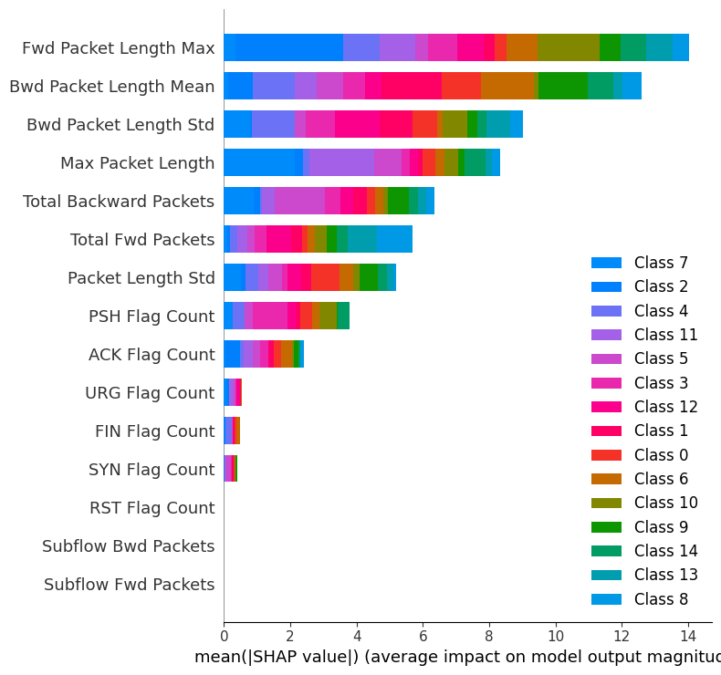
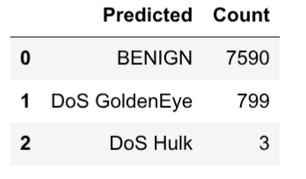
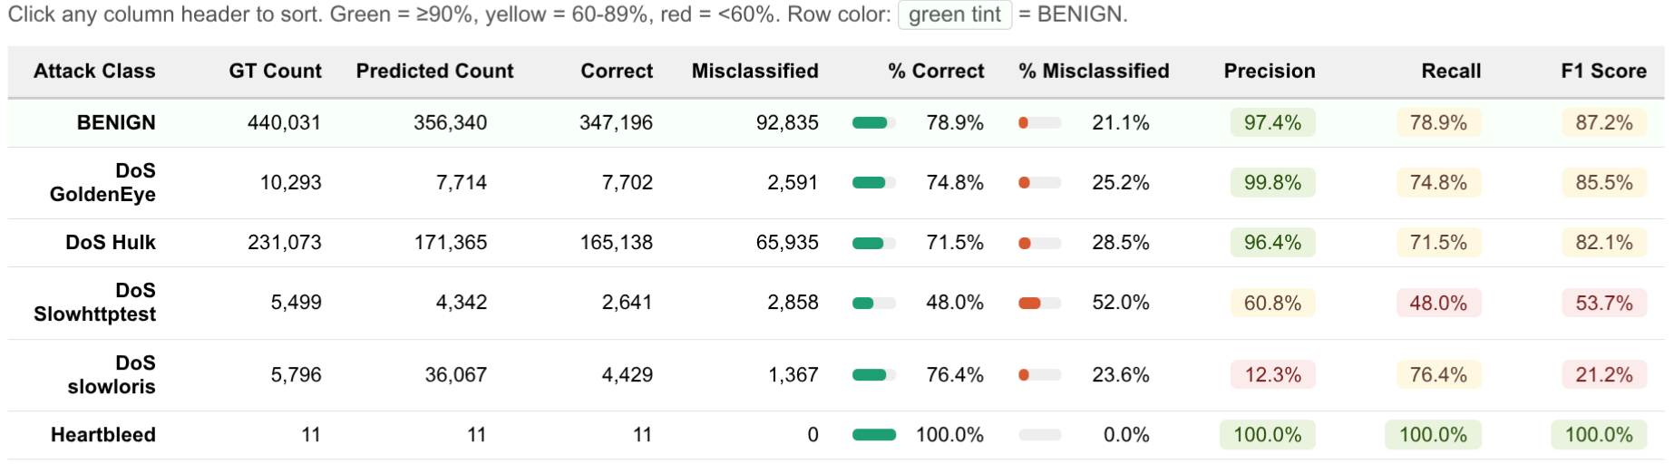
Retrained Model Part 2
70+ → 15 Features
Further reduced impactful features based on SHAP analysis
Feature pruning was too aggressive
VM Hulk DoS Results
CIC Inference results
Notes:
Andrew
Got 10.5% detection on real-world HulkDos which is not great but demonstrates with the correct features some detection of our dataset is possible. The max accuracy we could achieve is still unknown.
Got the SHAPley values after retraining and evaluating again. Saw fewer overfitted categories across the board. Further reduced to 15 features based on SHAP importance — focused on packet length stats and TCP flag counts
Final feature set: Fwd/Bwd Packet Length stats, Total Fwd/Bwd Packets, PSH/ACK/SYN/FIN/RST/URG Flag Counts, Subflow Fwd/Bwd Packets
Dataset accuracy dropped further: BENIGN 78.9%, DoS GoldenEye 74.8%, DoS Hulk 71.5%
Pruning was too aggressive: DoS Slowhttptest collapsed to 48.0% correct (F1: 53.7%) and DoS slowloris F1 fell from ~99% to 21.2%
Heartbleed improved to 100% recall — some classes benefit from the simpler feature space
Takeaway: 43 features hits the better real-world/benchmark balance; 15 features over-corrects
MENTION that because of the timing differences the retraining of features was only so successful

Slide 14

Notes:
Mason

Slide 15
Challenges & Limitations
No backward packets on initial attacks
Model overfitting initially
Dataset test metrics can be misleading for realworld implementation
Performance on baseline vs VM traffic drastically different due to differences in timing characteristics
Difficult to choose features maximizing timing diversity along with supported attack types (some success with DoS Hulk)
Notes:
Ben
We hit several challenges throughout this project, and I'll cover them at a high level.
First, our initial attacks didn't generate any backward traffic, since they used spoofed source IPs. The victim's responses went to fake addresses and never came back, which threw off the model since backward packet stats are some of its most important features.
Also, as covered earlier, the model overfit pretty heavily to its training data — meaning the impressive accuracy numbers we saw on the test set didn't necessarily translate to real-world detection. The dataset's test metrics can be really misleading when you try to deploy a model like this in practice. 99% accuracy on a benchmark sounds great, but it doesn't tell you how well the model will perform on traffic that doesn't perfectly match the training distribution.
When we compared our baseline performance to traffic generated in our VM environment, performance was drastically different — mostly due to differences in timing characteristics like flow duration and inter-arrival times between our setup and CIC's.
And finally, it was really difficult to design attacks that maximized timing diversity and matched one of the supported attack categories. We had some success with our DoS Hulk attack, but most of our other attacks didn't translate cleanly to anything the model recognized.

Slide 16
Conclusion & Future Work
Conclusion
Trained an XGBoost classifier on CIC-IDS-2017
Discovered the model overfits due to dataset’s lack of diversity
Feature reduction improved real-world detection at the cost accuracy
Future work
Re-train on different features
Using LIME and/or SHAPley to train with a combo of the CIC-IDS-2017 dataset and our own attacks
Real-time inference dashboard for live flow classification
Notes:
Ben
To wrap up — we trained an XGBoost classifier on the CIC-IDS-2017 dataset, and it performed extremely well on the dataset's own test split, hitting 99.86% accuracy and a macro F1 of 0.87. But when we validated it against attacks we generated ourselves, we discovered the model overfits to the specific lab environment CIC used to build the dataset, and doesn't generalize as cleanly as the test scores suggest.
Looking ahead, there are three main directions for future work. The first is retraining the model on a different features from the dataset. We saw that when changing the number of features down to 15, we got better results. With trial and error, we could potentially see the accuracy get to a usable point.
The second would be using LIME and/or SHAPley to train with a combo of the CIC-IDS-2017 dataset and network traffic from our own attacks. This would diversify the data that the model is trained on and hopefully lead to better results.
The third is a real-time inference dashboard for live flow classification. Instead of running the model in batch on saved captures, you'd stream live network flows through it and visualize attacks as they happen — closer to what a real SOC analyst would actually use day-to-day.
Overall, this project gave us a solid foundation in modern ML-based intrusion detection — both the parts that work well and the practical challenges of deploying these systems in the real world. Thanks for listening.

Slide 17
Q&A
Notes:
Q&A

